Slide 1
Final Presentation
Team 30
Jacqueline Nesbitt, Matt Pribadi, Kasha Muzila, Karl Eirich

Slide 2
Outline
Business Case (Audience/Metrics)
Background on Datasets
EDA, Feature Engineering and Dataset Join
Machine Learning Pipeline
Model Results
Gap Analysis
Performance and Scalability Concerns
Limitations, Challenges, and Future Work

Slide 3
Business Case (Audience)
All ground handling companies
United Ground Express (UGE), Unifi, Envoy, G2 etc.
Encounter 2 issues that prevent profitability:
Seasonality (low seasons)
Inefficient Staffing

Slide 4
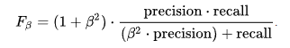
Business Case (Metrics)
Cost of False Positive
Could cause the flight to be delayed
Hurts airline “on-time” metric
GM’s bonus is reduced
Stressed employees hurts morale and increases accidents
F0.5 Measure
Cost of False Negative
Financial

Slide 5
Background on Dataset
Flights Table
Subset of passenger flights on-time performance
TranStats data collection
U.S. Department of Transportation (DOT)
31,746,841 x 109 dataframe
Weather Table
Weather data corresponding to stations which include airports
National Oceanic and Atmospheric Administration repository
630,904,436 x 177 dataframe

Slide 6
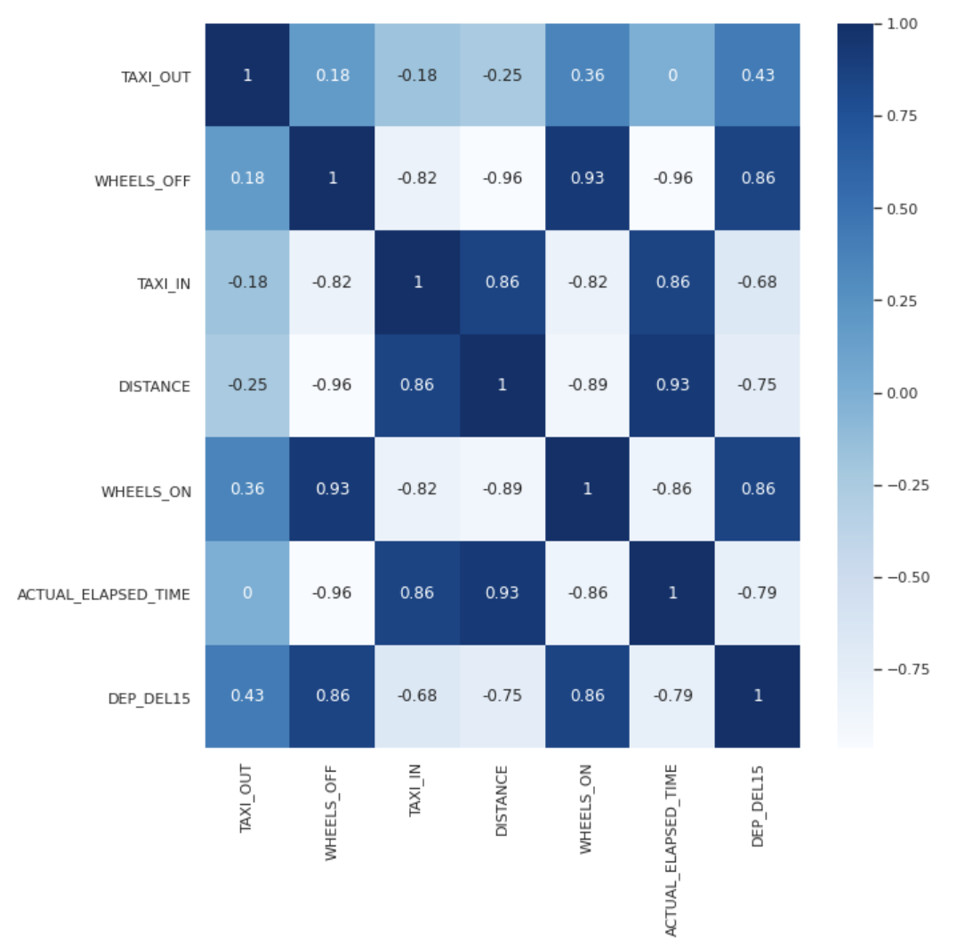
Flight EDA - Quantitative
Notes:
After removing all variables that had less than 50%

Slide 7
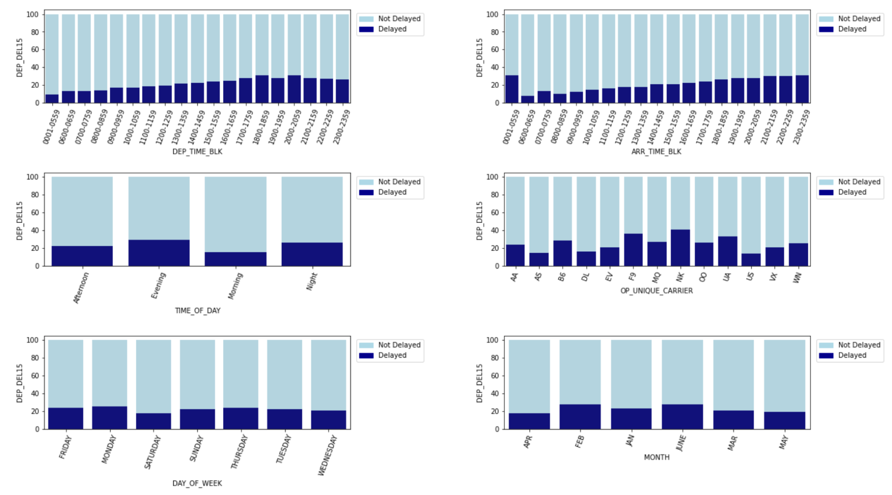
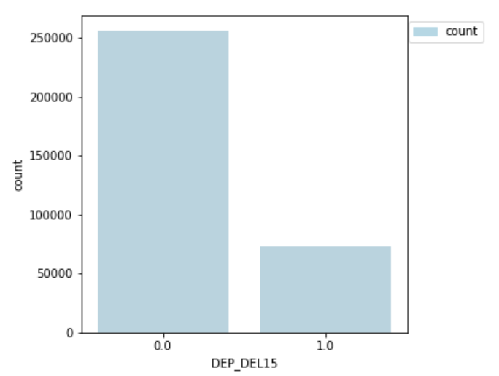
Flight EDA - Categorical
Predictive Variables
Target Variable
Notes:
Create a time of day variable which shows promise
We see variations in Unique carrier, day of week and month
Utilizing departure 15 mins or later binary, dropped canceled flights because according to our business case there’s a baseline staffing requirement for those canceled flights.

Slide 8
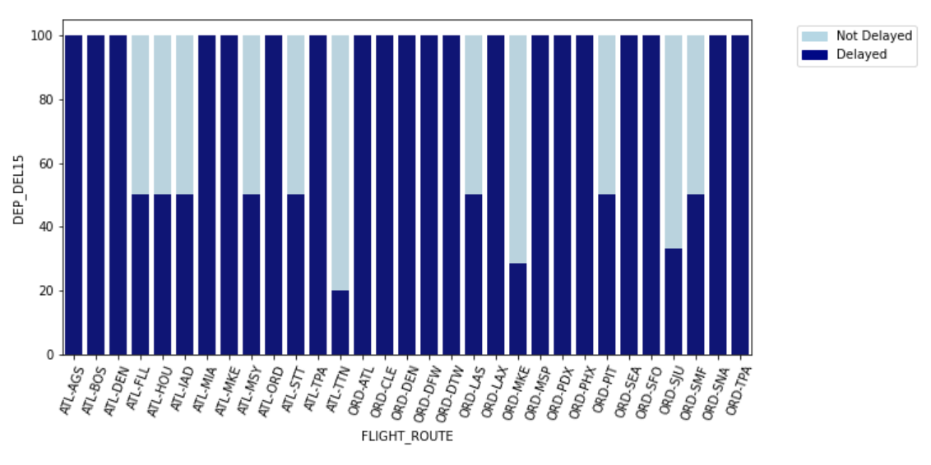
Flight Feature Engineering
Time of Day
Flight Route
- Unique ID: 'OP_UNIQUE_CARRIER + OP_CARRIER_FL_NUM'+'DATE_TIME'
- time conversion to UTC

Slide 9
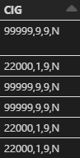
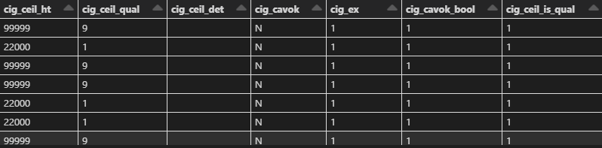
Weather EDA - Feature Engineering
Cleaning the data was key
Explode into individual columns
Transform into actionable columns
Notes:
CAVOK
Ceiling and Visibility Okay

Slide 10
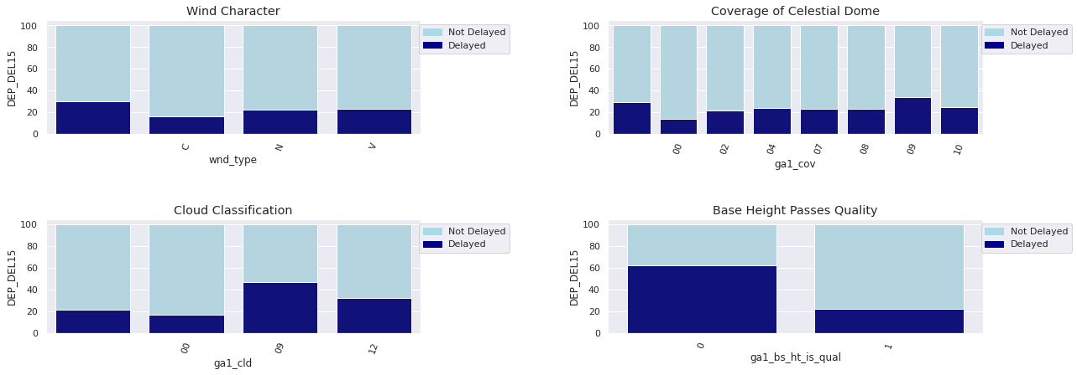
Weather EDA - Categorical
Notes:
Wnd_type
“”
Missing
C
Calm
N
Normal
V
Variable
Ga1_cov
The fraction of the total celestial dome covered
00
None
Clear
02
Two Oktas
2/10
Few
04
Four Oktas
5/10
07
Seven Oktas
9/10
08
Eight Oktas
10/10
09
Sky Obscured
Cannot Estimate
10
Partial Obscure
Ga1_cld
The classification of the clouds
00
Cirrus
09
Cumulonimbus
12
Towering Cumulus
*_is_qual
The addition of quality data aligns with delay data

Slide 11
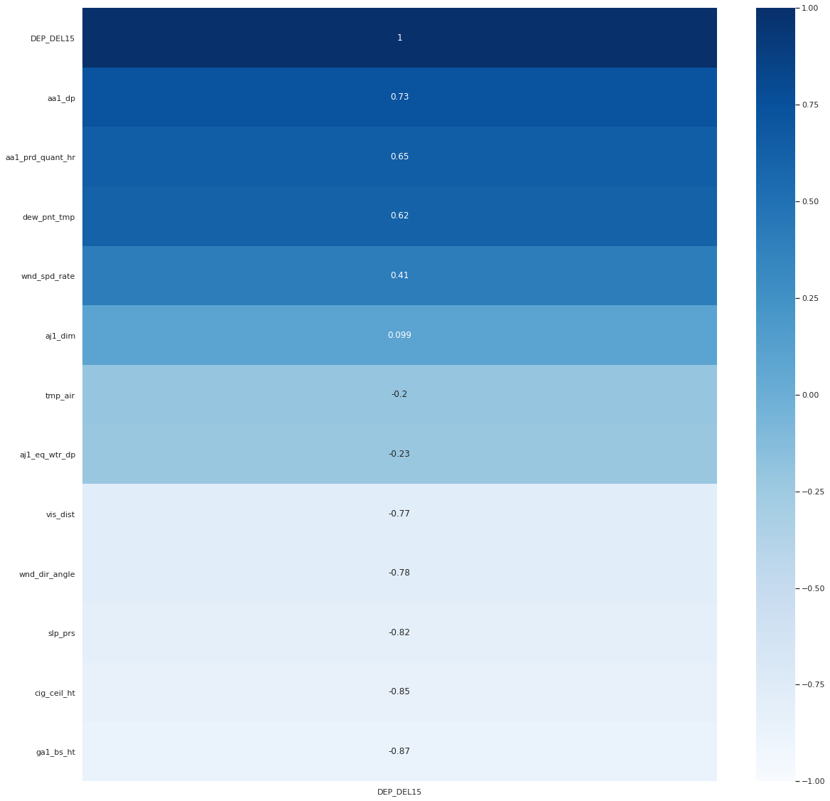
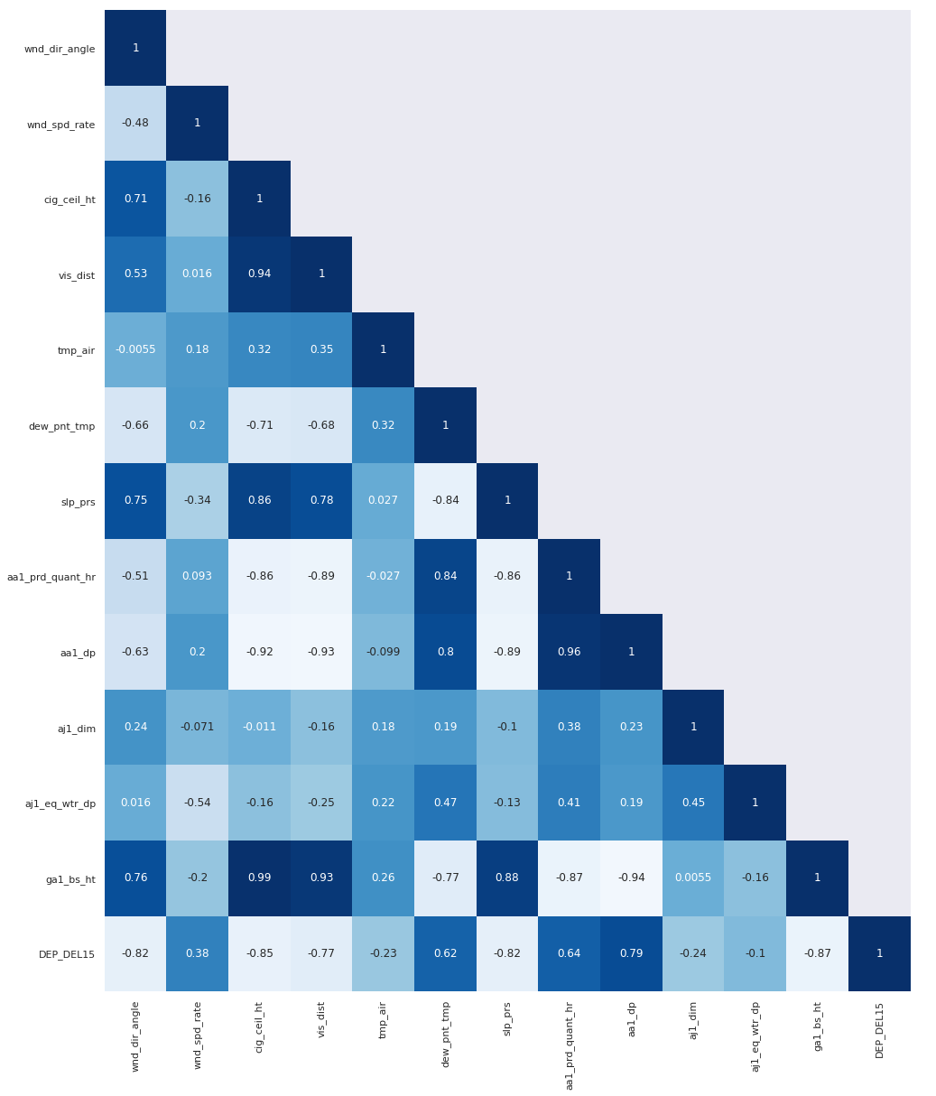
Weather EDA -
Quantitative
Rain
Snow
Cloud
Notes:
Aa1_dp
Depth of rain
Aa1_prd_quant_hr
Period of rain in hours
Dew_pnt_tmp
The temperature and water vapor content
Wnd_spd_rate
Wind speed
Aj1_dim
Depth of snow
Tmp_air
The mean air temperature
Aj1_eq_wtr_dp
Equivalent water depth
Vis_dist
The horizontal distance at which an object can be seen
Wnd_dir_angle
Angle of wind direction
Slp_prs
Atmospheric pressure
Cig_ceil_ht
The height of the lowest cloud
Ga1_bs_ht
Height of lowest cloud

Slide 12
Join Architecture
Provided
Added
Airport Time Zones
PK:
AIRPORT
Flight
PK:
Unique ID: TAIL_NUM + DATE_TIME
FK:
ORIGIN
DATE
Station
PK: station_id
FK:
neighbor_call
AIRPORT join ORIGIN
Station.neighbor_call join Flight.ORIGIN
Weather.STATION join Station.station_id
USA Time Zones
PK:
AIRPORT
Weather Data
PK: Unique ID: DATE + STATION + REPORT_TYPE
FK:
DATE
STATION
Weather.DATE join Fight.DATE
AIRPORT join ORIGIN
Notes:
To facilitate our join, we introduced two additional datasets tying back timezones to airport IATA codes. This allowed us to filter out the Flight’s dataset for only domestic departure and arrivals. To join the rest of the datasets, we had to create a key table to combine the Flights and Weather dataset. This was done with the Station dataset to link Weather Data to Flight data based on IATA airport codes. As part of the feature engineering, the flights dataset had a date feature transformed to UTC time in order to allow for the Flights and Weather datasets to be joined based on a one hour block, two hours from departure time.

Slide 13
Join Metrics
Key Stations
2043 Records 3 Columns
Station + Flights Join
Stations
31M Records 20 Features
500K Records 12 Columns
Joined Table
Time Zones
Flights Table
Weathers Table
42M Records 32 Features Time to Join = 4.4 hrs
47 Records 5 Columns
31M Records 18 Features
630M Records 255 Features
Notes:
This slide gives a more detailed look at the metrics of the joined dataset through each stage of the process. The first two datasets joined together were the Stations and Timezones dataset in order create a Key Station dataset linking United States Domestic IATA codes with stationID. Then this Key Station table was joined with the Flights table to ensure a record of domestic flights were accounted for (which didn’t result in much of a change in the dataset) and so that the flight dataset was augmented with the StationID. Then the joined Flight dataset was combined with the weather table based on two keys - StationID and Date, which resulted in a final joined dataset of 42 million records and 99 features - taking about 4.4hours to complete.

Slide 14
Pipeline: Pre-processing
Training/Test Dataset
Indexer
One Hot Encoder
Assembler (Categorical)
Cache
The entire dataset is put into the pipeline
Assign unique integer values to each categorical feature
Create columns of binary outcomes for each categorical feature
Create a single vector column for the categorical features
Transformed Dataset is persisted in storage and memory for efficient reuse
Notes:
After all the feature engineering, a comprehensive machine learning pipeline has to be created in order to allow for efficient reuse of pre-processing data to be used in model training. In our pre-processing pipeline, we send the dataset of interest through various stages in order to take advantage of a one-pass through transformation of categorical features. Here the categorical features in our dataset are sent through an indexer, one-hot encoder, and assembler before they are persisted in memory to allow for efficient reuse.

Slide 15
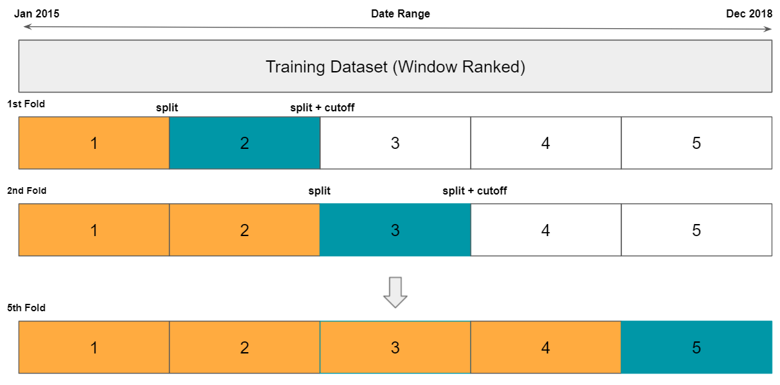
Pipeline:
Custom Gridsearch
Transformed Dataset
Parameter Grid Generated
Crossfold Validation
Scaled Pipeline
Best Parameters Stored
Transformed data from the pre-processing pipeline
Unique hyperparameter tuning per classification model
Day-forward Chaining +
Class Balancing (Downsample)
To be used for testing on unseen data
Imputer
Scaler
Assembler
Machine Learning Classifier
Fill in missing data with mean
Scaled data based on the crossfold split of data
Assemble both categorical and continuous features
Logistic Regression, Decision Tree, Random Forest
Notes:
This now transformed dataset is sent through our custom gridsearch function which has the following stages. First a parameter grid is generated for each classification model specific hypertuning parameters. For each set of hyperparameters tested, the data is split through our crossfold validation function that utilizes both day-forward chaining concepts and class balancing through downsampling. This split and balanced dataset is then sent through our scaled pipeline shown in green. Here the continuous features are sent through an imputer, scaler, and assembler before being fed into our machine learning classifier of interest - Logistic Regression, Decision Trees, and Random Forest. We do the continuous feature processing here in order to prevent data leakage based on future data. From here the crossfold validation function generates an average F0.5 score based on the hyperparameters tested and stores that for the next iteration. Based on the best average F0.5 score, we save the best hypertuned parameters to be used for the unseen dataset (in our case, 2019 data).

Slide 16
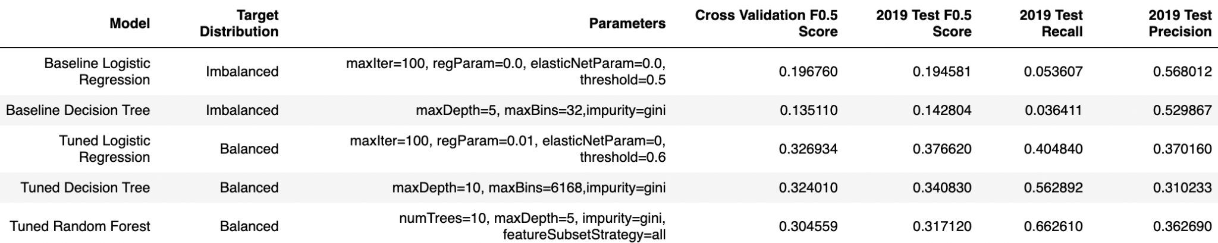
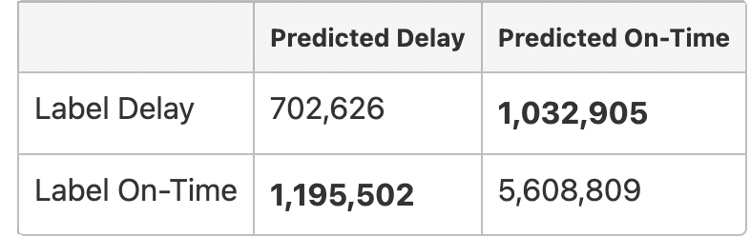
Model Results and Implications
Notes:
We used two models as our baseline classifiers: Logistic Regression and Decision Tree Classification
Logistic Regression
Logistic regression aims to limit the cost function between 0 and 1, making it a good candidate for classifying our binary delay label
Logistic regression does well when thrown many features, as long as there are no null values, and creates a prediction function to be used in classifying a label based on a probability threshold
Decision Tree Classification
For datasets with a large number of features, decision trees does a good job of predicting an outcome (even if there are nulls or bad data)
Resulting information gain is highly translatable to business objectives and can be used in decision making for choosing which features to pay attention to
Overall, these two models are easiest to run at scale
We ran these baseline models through crossfold validation, training on 2015-2018 data and validating on 2019 data and the results are shown here.
Image References:
https://devopedia.org/decision-trees-for-machine-learning
https://towardsdatascience.com/introduction-to-logistic-regression-66248243c148

Slide 17
Gap Analysis
Evaluate the size of our time window
Potentially use GBTClassifier, XGBoost, or Ensemble
Identify improvements in feature engineering

Slide 18
Performance & Scalability Concerns
Performance Concerns
Data transformation
Dataset Size
Model scores
Scalability Concerns
The pipeline stages
Data redundancy
Classification Model Limits

Slide 19
Limitations, Challenges, and Future Work
Limitations
Looking at 1hr time block, 2 hrs from departure time
Focused on FM-15 and FM-16
Disregarded any geological aspects (latitude and longitude)
Imputing on the entire column instead of nearby values
Only used a small number of hyperparameters
Challenges
Long training and testing times
Doing proper crossfold validation and integration with the pipeline
Low evaluation metrics
Future Work
Include more weather data ahead of flight
Implement random search instead of grid search

Slide 20
Thank you!
Q&A

Slide 21
Gap Analysis
Pipeline Errors
Kryo Serialization Failed
Buffer Overflow
Illegal Argument Exception
Requirement Failed
F1 Metric Validity
Debugging Experience
Lots of searching
Eventual refactor
No known solution
Learned about forced typing when reading datasets
Change ‘f1’ to ‘fMeasureByLabel’
Notes:
https://stackoverflow.com/questions/68213862/how-to-use-f1-score-for-crossvalidator-evaluator-in-a-binary-problembinaryclass
https://spark.apache.org/docs/latest/api/python/reference/api/pyspark.ml.evaluation.MulticlassClassificationEvaluator.html

Slide 22
Cross Validation (5-fold Example)
Train
Validate
Not Used
Jan 2015
Date Range
Dec 2018
Training Dataset (Window Ranked)
1st Fold
split
split + cutoff
1
2
3
4
5
2nd Fold
split
split + cutoff
1
2
3
4
5
5th Fold
1
2
3
4
5
Notes:
For crossfolding, we had to create a custom crossfold validation function due to the time-based nature of the dataset
This slide shows an example of how we implemented our crossfold validation on the basis of “day-forward” chaining
Here at the top, the total training dataset is shown in gray and encompasses values from January 2015 through Dec 2018
The following is an example of how the data would be split into training and validation in order to generate our metrics and to determine the best model
As an example, for the first fold - the first 1/5th of the data would be used for training and the 2nd 1/5th of the data would be used for validation.
Skipping to the final fold - 4/5ths of the data is used for training and the final 1/5th is used for validation.
This is all done to prevent data leakage in training on future values

